Slide 1
„Business driven problem-based learning for academic excellence in geoinformatics” - GEOBIZ project
Author: Vesna Poslončec-Petrić, Željko Bačić
Institution: Faculty of Geodesy, Zagreb

Slide 2
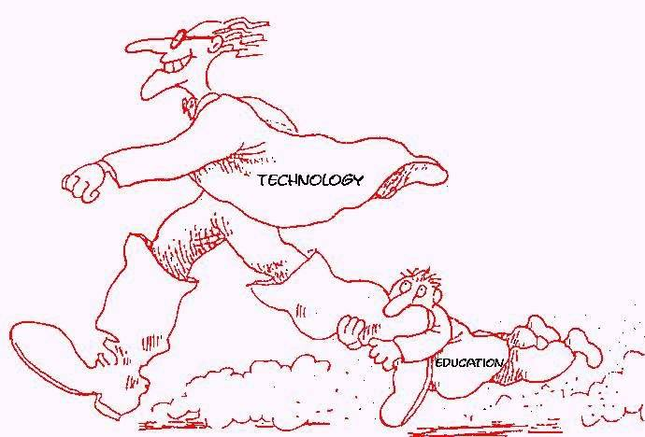
Motivation
There is continuous request on academic institutions to introduce study programs which will in practical part based on case-based problems coming from business sector.
This request understands change of way how practical part of university courses are conducted and establishing new form of academia-business cooperation.

Slide 3
Motivation
This challenge, also recognized in frame of BESTSDI project has become leading idea for new project proposal which would introduce problem based practical part of geoinformatic course in geodesy-geoinformatics study programs at higher education institutions in Albania, Bosnia and Herzegovina, Kosovo, Moldavia and Montenegro

Slide 4
Towards project proposal
Answering on challenges which came from the project idea, new form of consortia should be established.
Beside academic institutions also private companies should be included while National Mapping and Cadastre agencies should remain key benefactors as associated partners.

Slide 5
Project proposal
Erasmus+ programme Call for Proposals 2019 - EAC/A03/2018
GEOBIZ Project application submitted on 07/02/2019 in category Cross-regional project
Notification of Project acceptance on 03/08/2019 (acceptance rate 9,43%)
Grant 989.055 Euro
Start of Action on 15/11/2019

Slide 6
GEOBIZ consortium
Project coordinator:
University of Zagreb, Croatia
Program countries:
Catholic University of Leuven, Belgium
University of Split, Croatia
Bochum University of Applied Sciences, Germany
University of Beograd, Serbia
University of Novi Sad, Serbia
GILab Ltd., Serbia

Slide 7
Partner countries:
Polytechnical University of Tirana, Albania
University of Tirana, Albania
Land & Co. Ltd, Tirana, Albania
University of Banja Luka, Bosnia and Herzegovina
University of Sarajevo, Bosnia and Herzegovina
Gauss Ltd, Bosnia and Herzegovina
University of Pristina, Kosovo
University for Business and Technology, Kosovo
Technical University of Moldavia, Moldavia
State University of Tiraspol, Moldavia
University of Montenegro, Montenegro

Slide 8
GEOBIZ partners
Associated partners:
Federal Administration for Geodetic and Real Property Affairs of FBiH (FGU) - Bosnia and Herzegovina
Real Estate Administration of Montenegro (REA) - Montenegro
Agency for Land Relations and Cadastre of the Republic of Moldova (ALRC) - Moldova
State Authority for Geospatial Information (ASIG) - Albania
Kosovo Cadastre Agency (KCA) - Kosovo

Slide 9
GEOBIZ - Aims and objectives
The main aim of the GEOBIZ project is strengthening the capacity of academic institutions to better respond to the needs of the emerging geoinformatics industry in Albania, Bosnia and Herzegovina, Kosovo, Moldova and Montenegro with emphasis on the following aspects:
Establishing new and innovative forms of business-academia cooperation to support interaction in teaching/learning processes in geoinformatics.
Establishment of business-academia platform supporting excellence in geoinformatics.

Slide 10
GEOBIZ - Aims and objectives
Developing innovative teacher training programs and practical teaching/learning methodologies and content in technology-based courses in geoinformatics leaned on business-driven needs and experience.
Implementing state-of-the art techniques in geoinformatics teaching process.

Slide 11
GEOBIZ – Specific objectives
In other to achieve the main objective, the project specific objectives are:
To improve and increase business-academia cooperation in geoinformatics at partner universities.
Establish business-academia interactive training program for teachers of geoinformatics courses following Bologna standards.
To create of technological preconditions (establishment of geoinformatics labs) for partner HEI’s.

Slide 12
GEOBIZ – Specific objectives
Develop and pilot number of improved university (practical part) and LLL courses.
Set up technological platforms to share business-based practical examples in geoinformatics among partners and countries.
Embed a culture of quality to the project, its outputs and outcomes.
Facilitate adequate management tools for the correct implementation of the project.

Slide 13
WP1 – Analysis of present business-academia ecosystem
Task 1.1 – Survey of business and user needs in geoinformatics
Task 1.2 – Survey on business-academia cooperation practices
Task 1.3 – Geoinformatics curriculum analysis and comparison with EU models

Slide 14
WP2 – Model, Courses, Knowledge & Preconditions Development
T2.1 Business-academia cooperation model design
T2.2 Developing innovative business-problem based cases
T2.3 Geoinformatics courses (practical part) design
T2.4 Geoinformatics LLL courses design
T2.5 Training of teachers
T2.6 Acquisition of equipment

Slide 15
WP3 – Cooperation & Courses Implementation
T3.1 Establishment of business-academia cooperation platform in geoinformatics
T3.2 Implementation of developed courses in study programs
T3.3 Piloting developed courses at partner universities
T3.4 Piloting developed LLL courses
T3.5 Evaluation of piloted courses
T3.6 Establishment of inter-partner geoinformatics problem-based cases repository

Slide 16
WP4 – Quality Control & Evaluation
T4.1 Establishment of internal work quality standards & procedures
T4.2 Quality assessment and evaluation
T4.3 External independent monitoring evaluations

Slide 17
WP5 – Dissemination & Exploitation of Project Results
T5.1 Communication Plan and establishment of project website and social media
T5.2 Maintenance of project website, social media and newsletter
T5.3 Dissemination and Exploitation Plan
T5.4 Dissemination & Exploitation material production and activities
T5.5 Organization of business-academia workshops

Slide 18
WP6 – Project Management & Sustainability
T6.1 Project management structure establishment
T6.2 Project management, administration and monitoring
T6.3 Project financial management
T6.4 Progress and final report to EACEA and financial audit
T6.5 Project sustainability

Slide 19
GEOBIZ beneficiaries and expected results
Project planned activities and the expected results satisfy needs of those target groups in all Partner Countries as follows:
HEI students – new modern technologically advanced and on real business-driven problem-based cases designed geoinformatics courses will be designed, implemented and introduced in curriculum of partner universities enabling the students to gain advanced geoinformatics knowledge and skills required by business sector from new graduate entering industry.
HEI teachers – through participation in the project more than 50 teachers will undercome advanced geoinformatics training and supplemental education in specific geoinformatics topics, trained in practical case, theory and methodology. Purchased equipment will allow teachers to implement designed courses and continuously work on their upgrade in cooperation with business sector.

Slide 20
GEOBIZ beneficiareies expected results
Geoinformatics companies – Improve cooperation with academic sector, get another source of information, get access to student population and be in position to choose best students for their businesses, influence curriculum modernization process in accordance to their needs and get partner in scientific and professional projects.
Geoinformatics and related professionals – will get in first line who is building geoinformatics ecosystem in their country. Further, new sources and tools of communication and platform for cooperation with possibility to choose level of involvement. The bidirectional communication, supported also from side of governmental and public institutions, will foster development and growth of geoinformatics and related sectors.

Slide 21
GEOBIZ beneficiaries and expected results
HEI’s providing geoinformatics studies – on institutional level HEI’s involved in project will strengthen their internal capacities and gain higher attraction of the scholars for inscription in geoinformatics and related study programmes what is relevant issue for many HEI’s in Europe.
Governmental authorities, public administration and agencies – as a final and in Partner countries most important user of geoinformatics services and products this group of stakeholders in profiting with all components and results of the project.

Slide 22
Thank you for your attention!
www.bestsdi.eu
info@bestsdi.eu
----
This project has been funded with support from the European Commission. This publication [communication] reflects the views only of the author, and the Commission cannot be held responsible for any use which may be made of the information contained therein.

